Slide 1
New York Conference on Asian Studies Fall 2023 Book Presentation and Discussion, co-sponsored by SUNY Press
October 14, 2023

Slide 2
Schedule
10:00 WELCOME AND INTRODUCTION by Natalie Sarrazin, NYCAS President
ANNOUCEMENT FROM SUNY Press by James Peltz, Editor-in-Chief
10:10 NYCAS BUSINESS MEETING
Election for NYCAS Board
Marleigh Grayer Ryan Student Writing Competition winners
Acknowledgement by Hiromi Dollase, NYCAS Executive Secretary
10:20 KEYNOTE SPEECH by Dr. Albert Welter
“The Future of China’s Past: Reflections on the Meaning of China’s Rise”
11:05 GRADUATE STUDENTS ROUNDTABLE
Jeung Hyun Kim (Syracuse University)
Shu Wan (University at Buffalo, SUNY)
Bingwan Tian (University at Buffalo, SUNY)
Nat Smith (University of Michigan)
Jimmy Ngai (The University of Hong Kong)
Xinyi Ye (University of Pennsylvania)
Qi Zhang (Autonomous University of Barcelona)
Kennedy Zhang (Columbia University)
Wu Jie (University of Chicago)
12:30 Wrap-up

Slide 3
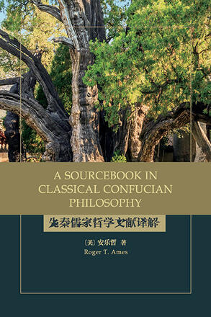
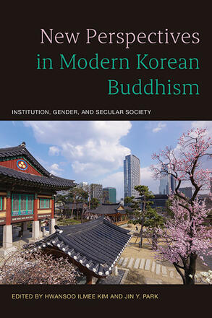
SUNY Press is pleased to offer a 30% discount to NYCAS conference attendees www.sunypress.edu – use coupon code NYCA23 through 11/14/23

Slide 4
Election
Nominee for a NYCAS Board Member (2023-2027)
Tiantian Zheng is SUNY Distinguished Professor at State University of New York, Cortland, with a Ph.D. in Anthropology from Yale University. She is the author and co-author of eleven academic books, five edited journal issues and over a hundred articles. She has received four national book awards: 2010 Sara Whaley Book Award (Red Lights), 2011 Research Publication Book Award (Ethnography of Prostitution), 2022 Research Publication Book Award (Violent Intimacy), and the Choice award of “Outstanding Academic Title" (Tongzhi Living). She has testified before Congress, UNAIDS, and the United Nations and has been a featured guest speaker on NPR, BBC, and NBC. She has delivered over 100 invited talks at key universities worldwide. Her latest ethnography Violent Intimacy:​ Intimate Partner Violence in Postsocialist China was published in 2022.

Slide 5
2023 Marleigh Grayer Ryan Student Prize
We would like to extend our gratitude to Dr. Tiantian Zheng for coordinating the selection of the prize winners.
2023 Marleigh Grayer Ryan graduate Student Prize
JEUNG HYUN KIM
SYRACUSE university
“GRANDPARENTING, FILIAL PIETY, AND WELL-BEING OF CHINESE-AMERICAN OLDER ADULTS”

Slide 6
2023 Marleigh Grayer Ryan
graduate honorable mention Student Prize
CAIYANG XU
COLUMBIA UNIVERSITY
“THE POLITICIZATION OF THE MAHĀYĀNA DISTINCTION IN MODERN CHINA, 1911-1953”

Slide 7
2023 Marleigh Grayer Ryan undergraduate Student Prize
WANQING ZHOU
UNIVERSITY OF ROCHESTER
“WHAT DO YOU MEAN BY ‘LOVE’: INTIMACY, COMMODIFICATION, AND COMMUNITY AMONG CHINESE KPOP FANS”

Slide 8
2023 Marleigh Grayer Ryan undergraduate honorable mention Student Prize
KIRSTIE YUEN
SKIDMORE COLLEGE
“DOES A DAOIST GENUINELY VALUE CLOSE RELATIONSHIPS?”

Slide 9
Future NYCAS Conference
NYCAS Conference
in 2024
We are actively looking for host schools for future conferences!
If you are interested, please email Hiromi Dollase, NYCAS executive secretary (hidollase@vassar.edu)

Slide 10
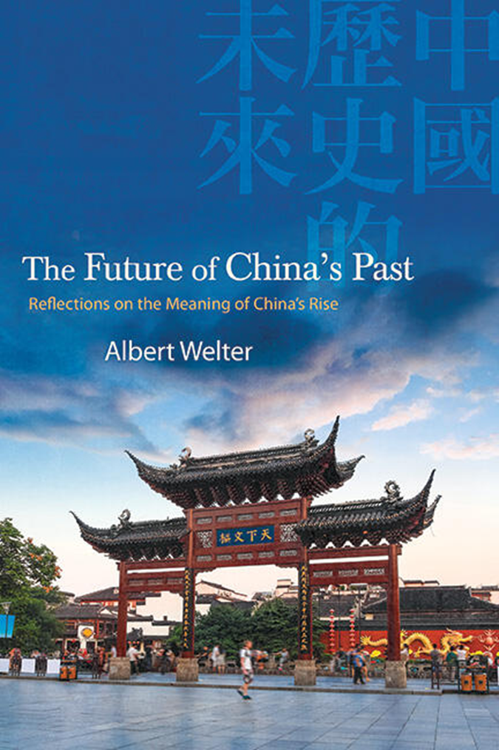
Keynote Speech by Dr. Albert Welter (University of Arizona, East Asian Studies Department)
The Future of China’s Past: Reflections on the Meaning of China’s Rise
(SUNY Series in Chinese Philosophy and Culture) 2023

