Slide 1
Faculty Development Center SUNY New Paltz

Slide 2
FDC Mission: Teaching Excellence – Professional Development
The Faculty Development Center provides resources and support to create and sustain a culture of teaching and learning excellence, to advance creative and innovative pedagogy, and to facilitate faculty scholarship and professional development.

Slide 3
New Faculty Welcome & Mentoring
How will you enter the classroom on your first day?
What brought you to this job and what do you intend to accomplish?
What were your students’ best learning experiences this fall?
How will you create accountability structures for your scholarship next semester?

Slide 4
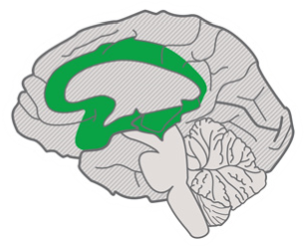
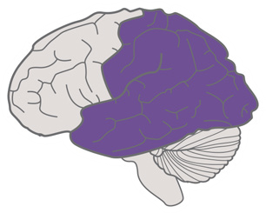
The Universal Design for Learning Guidelines
Provide multiple means of
Provide multiple means of
Provide multiple means of
Engagement
Representation
Action
Expression
&
Affective Networks
Recognition Networks
Strategic Networks
The “WHY” of Learning
The “WHAT” of Learning
The “HOW” of Learning
Provide options for
Provide options for
Provide options for
Recruiting Interest
Perception
Physical Action
Access
(7)
(1)
(4)
Optimize individual choice and autonomy
Offer ways of customizing the display of information
Vary the methods for response and navigation
(7.1)
(1.1)
(4.1)
Optimize relevance, value, and authenticity
)
Offer alternatives for auditory information
)
Optimize access to tools and assistive technologies
(7.2
(1.2
)
Minimize threats and distractions
Offer alternatives for visual information
(4.2
Campus-wide
Pedagogy Workshops:
Universal
Design
For
Learning
Guidelines
(7.3)
(1.3)
Provide options for
Provide options for
Provide options for
Sustaining Effort & Persistence
Language & Symbols
Expression & Communication
(8)
(2)
(5)
Heighten salience of goals and objectives
Clarify vocabulary and symbols
Use multiple media for communication
Build
(8.1)
(2.1)
(5.1)
Vary demands and resources to optimize challenge
)
Clarify syntax and structure
)
Use multiple tools for construction and composition
(8.2
(2.2
)
Foster collaboration and community
Support decoding of text, mathematical notation,
(5.2
(8.3)
Build fluencies with graduated levels of support for
Increase mastery-oriented feedback
and symbols
)
(8.4)
(2.3)
practice and performance
Promote understanding across languages
(5.3
)
)
(2.4
Illustrate through multiple media
(2.5
Provide options for
Provide options for
Provide options for
Self Regulation
Comprehension
Executive Functions
(9)
(3)
(6)
Internalize
Promote expectations and beliefs that
Activate or supply background knowledge
Guide appropriate goal-setting
(3.1)
(6.1)
optimize motivation
Highlight patterns, critical features, big ideas,
Support planning and strategy development
(9.1)
)
)
(6.2
Facilitate personal coping skills and strategies
and relationships
)
)
(9.2
(3.2
Facilitate managing information and resources
)
(6.3
Develop self-assessment and reflection
Guide information processing and visualization
)
(9.3)
(3.3
Enhance capacity for monitoring progress
)
(6.4
Maximize transfer and generalization
(3.4
Goal
Expert learners
who are...
Purposeful & Motivated
Resourceful & Knowledgeable
Strategic & Goal-Directed

Slide 5
Innovative, Engaged, Student-Centered Teaching
More effective teaching
Listening to student voices
Better learning experiences
Increased job satisfaction
Faculty Retention
Student Retention

Slide 6
Educational Technology Partnership with OIT

Slide 7
INTERNATIONAL VIRTUAL EXCHANGE: New Paltz, Esopus Munsee territory - Tarragona, SPAIN
Promoting Global Engagement Through
Collaborative Online International Learning (COIL)
Notes:
Also dealing with a severe COVID upsurge. Ice-breaker – choose your favorite UN SDG – many chose Good Health and Well being.

Slide 8
Applied & Experiential Learning Opportunities

Slide 9
Supporting Scholarship & Creative Projects
Free Editing & Proofreading for Scholarly Manuscripts, Grant Applications, Curricular Materials
Writing Groups 3 days / week
10-minute Accountability Check-ins to keep your research agenda on track
Strategies and organizational tips to plan for a successful semester via National Center for Faculty Development & Diversity
Grant-writing guidance
Outreach to other campuses for mentors

Slide 10
Foster faculty connection through community events and reciprocal mentoring opportunities

Slide 11
Faculty/Staff Adventure Group

Slide 12
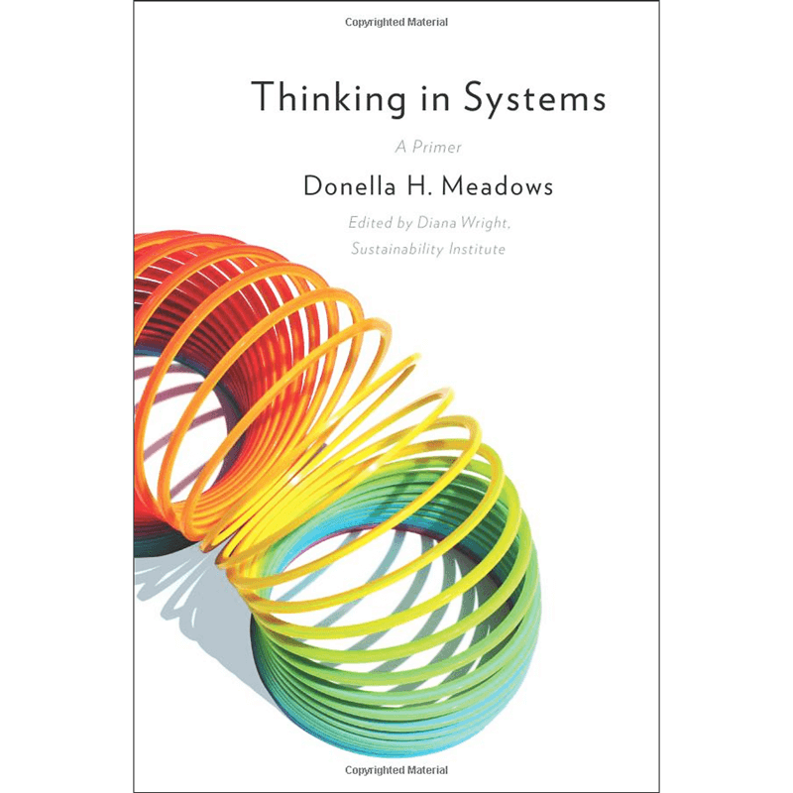
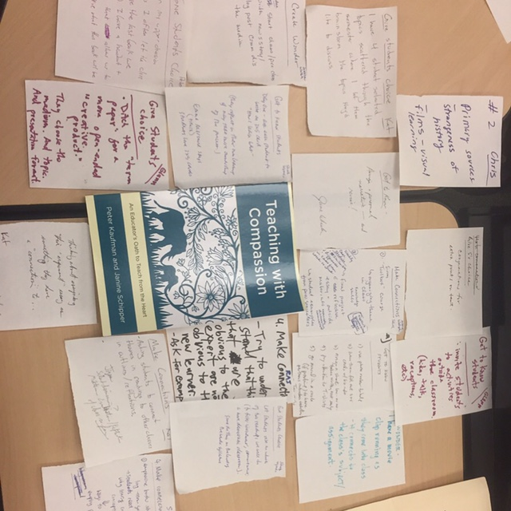
Book Discussions, Presentations & Study Groups

Slide 13
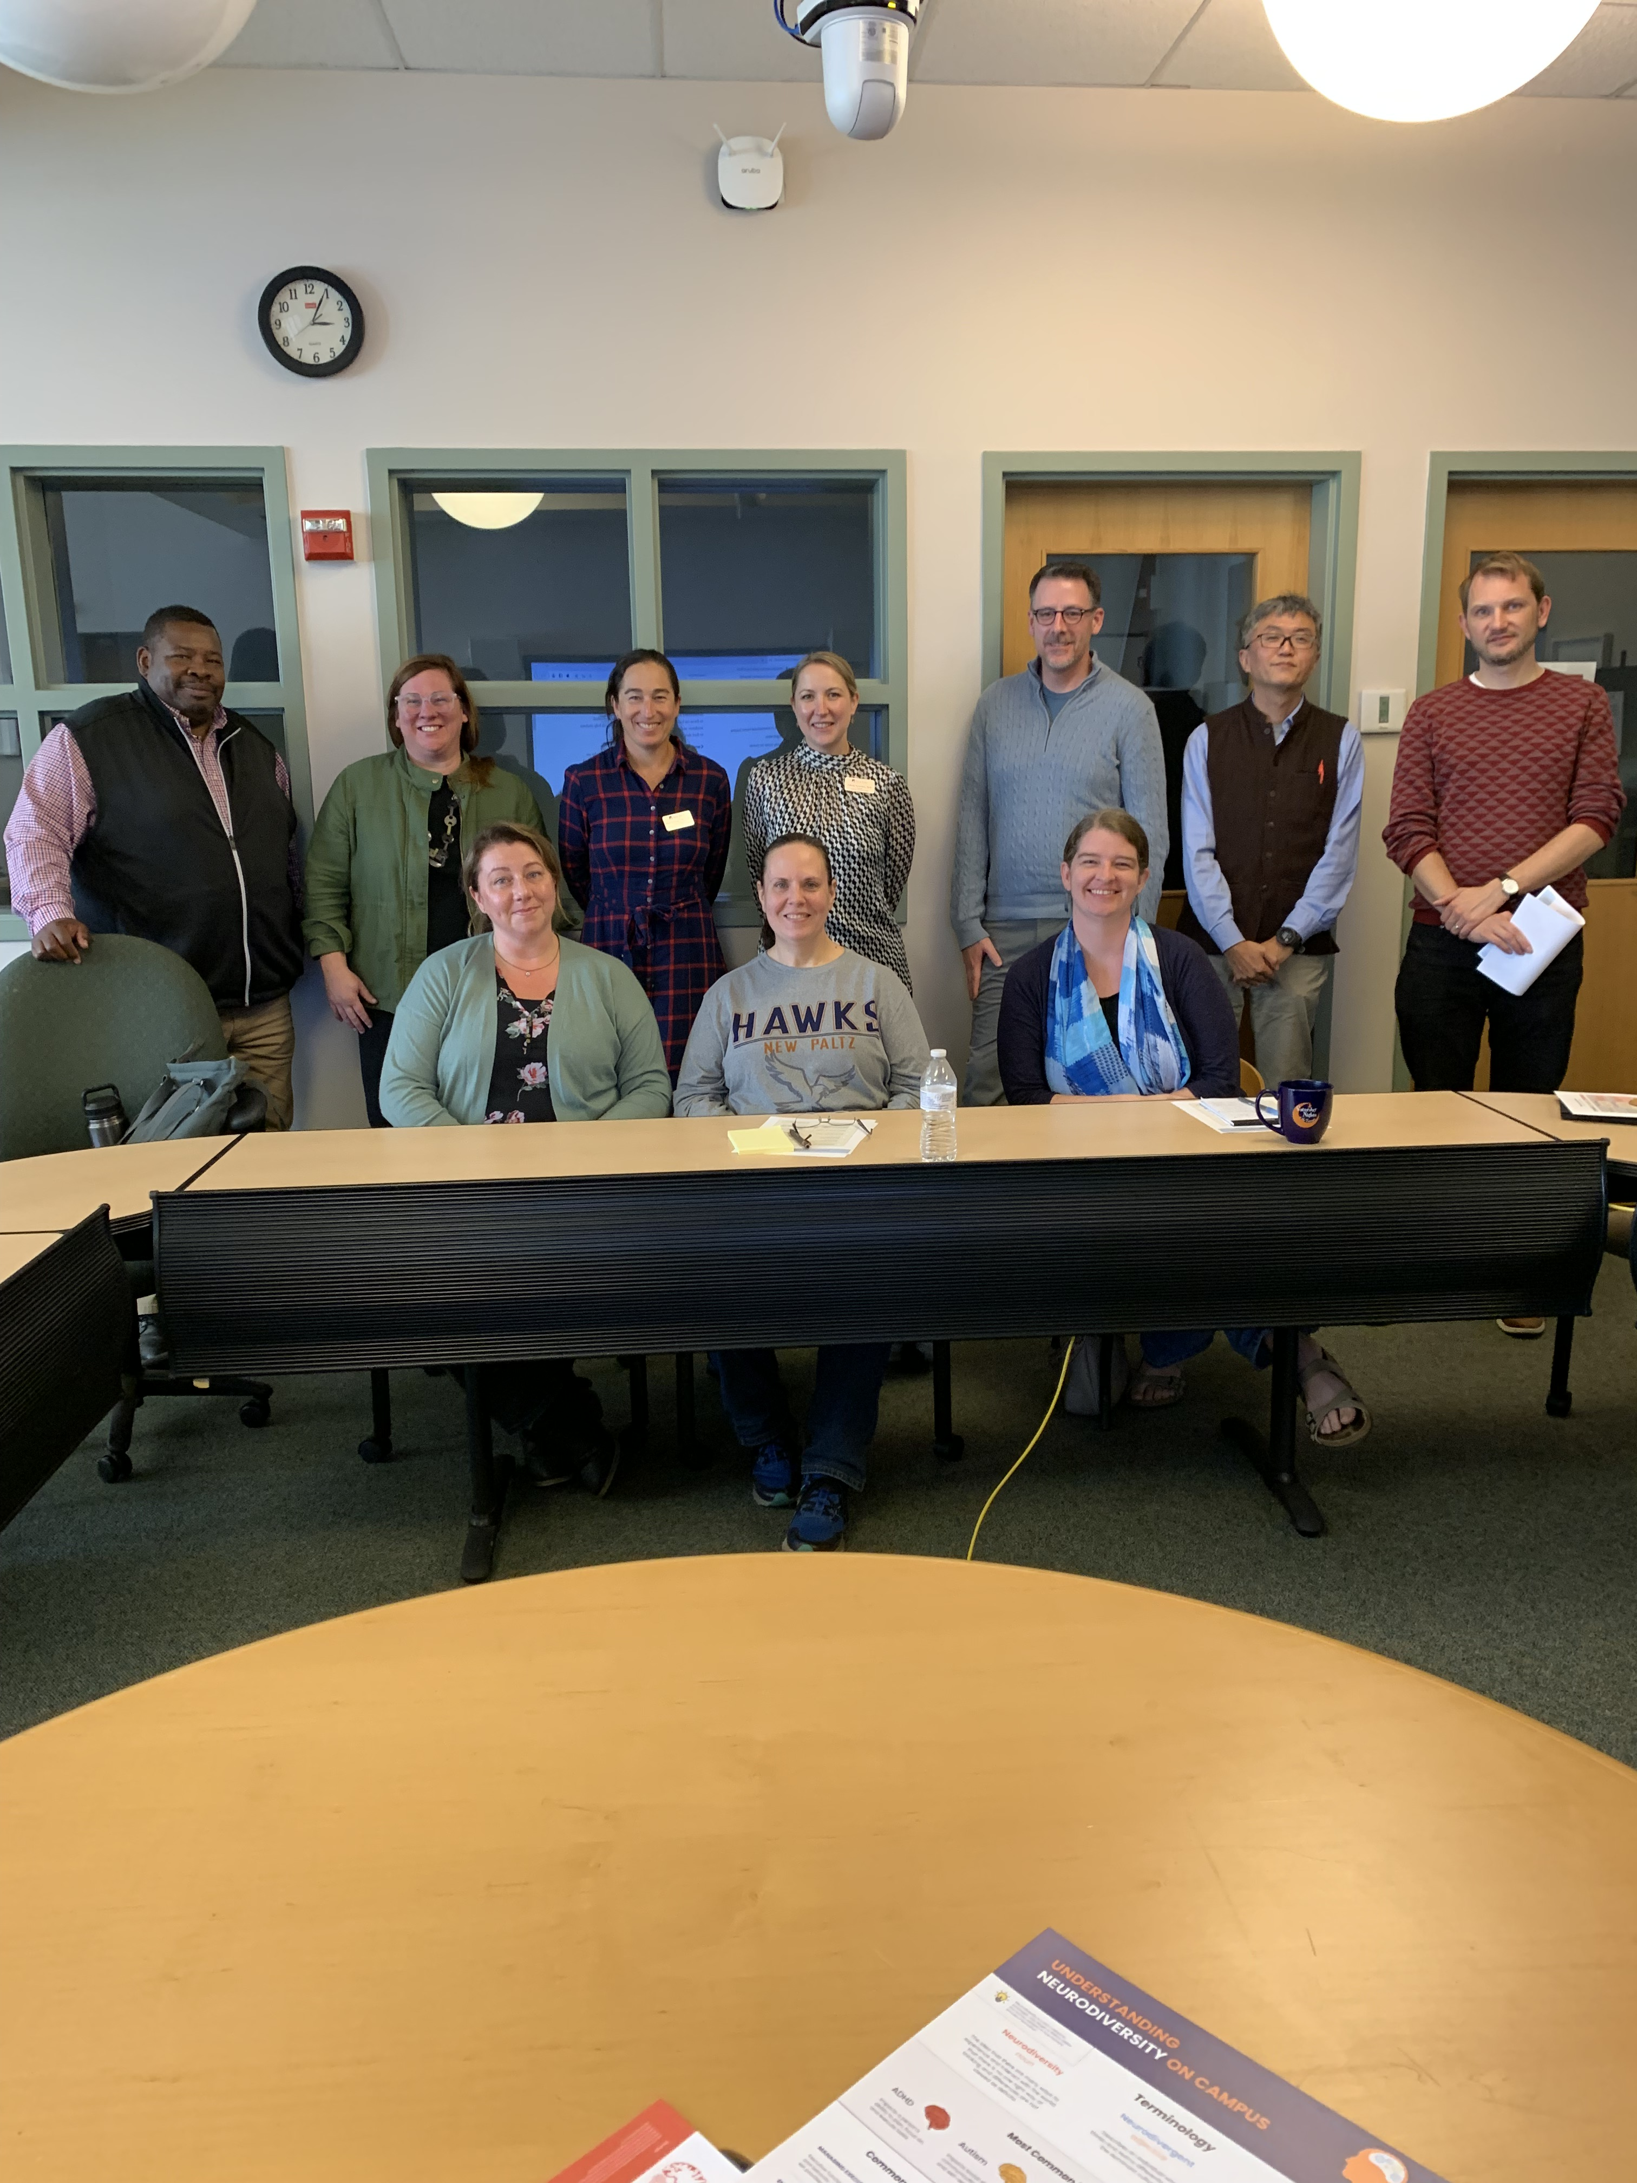
Disability Resource Center Veteran & Military Services Volunteer Prison Teaching
Tea & Coffee with Laura Wyeth
at the Greenhouse

Slide 14
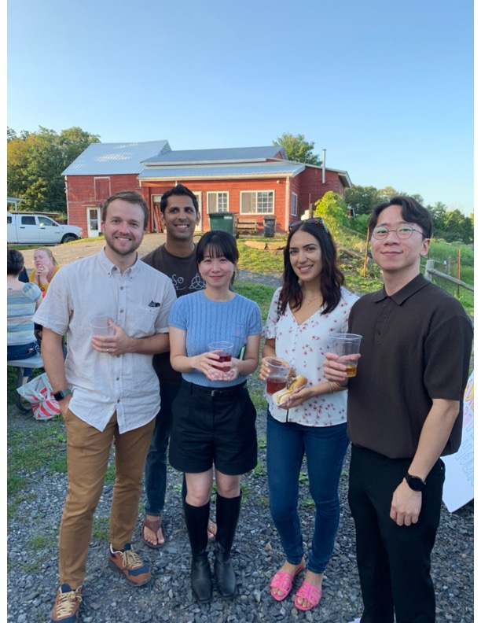
RTP Forum for early career faculty
5 Criteria
Board of Trustees
Mastery of Subject Matter
Effectiveness in Teaching
Scholarly Ability / Creative Projects
University Service
Continuing Growth

Slide 15
Supporting distressed students and addressing mental health concerns

Slide 17
Advisory Board – A Cross-Campus Network
Kathryn Bohan, Instructional Technology
Zachary Bowman, Samuel Dorsky Museum of Art
Helena Costakis, School of Business
Anthony Dandridge, Black Studies
Devon Duhaney, Teaching and Learning, Latin American & Caribbean Studies
Jason Gilliland, Veteran and Military Services
Dick Halpern, Physics & Astronomy
Andrea Kantrowitz, Art Education
Christina Koehne, Mathematics
Heather Lai, Engineering
Edward Lawson, Black Studies
Stephan Macaluso, STL Library
Rich McElrath, Instructional Technology
Rachel Rigolino, English
Reynolds Scott-Childress, History
Rachmadian (Doni) Wulandana, Engineering
Michelle Woods, English

