Slide 1
Collaborative Online International Learning
Connecting across differences for learning, collaboration and understanding
Notes:
Start by explaining what COIL is, then situate SUNY in the broader field of virtual exchange/international ed. Why COIL is strategic, examples from SUNY, and work of the COIL Center

Slide 2
COIL Pedagogy
Notes:
Project based, active applied learning relevant to the coursework, developing intercultural and interpersonal skills

Slide 3
Your Partner’s
Course
Your Course
International Perspectives
Your COIL Collaboration
Notes:
Sweet spot

Slide 4
COIL Characteristics
International experience integrated into existing courses. Typically 5-8 weeks as a major class project (graded).
Professors partner to design the experience. Aligned to learning goals.
Students have agency.
Any subject, any level. Often interdisciplinary.
Synchronous and asynchronous interactions.

Slide 5
Professors:
Define learning outcomes
Determine the length of interaction
Design comparative and collaborative activities
Select methodology and technology
Monitor student work and learning
Assess and evaluate student outcomes
COIL Pedagogy
Notes:
BACK TO MODEL. Roles of profs and students

Slide 6
Students:
Develop an effective international team
Discuss issues, course content
Problem solve
Complete a project-based assignment as part of their coursework
COIL Pedagogy
Notes:
Training profs to help students use reflective practice to develop critical thinking skills: suspend judgement, analyze factors contributing to a situation, clarifying & information gathering, applying

Slide 7
SUNY in the field of
Virtual Exchange

Slide 8
Virtual Exchange in Higher Ed
Online skills for dialog, understanding, learning and work.
Digital Professionalism
Partnerships
Intercultural
Work readiness
Significant, sustained and meaningful interactions develop and deepen partnerships.
Develops intercultural skills, understanding of different backgrounds and broader worldviews.
Interpersonal skills, teamwork, global perspectives, flexibility.
8

Slide 9
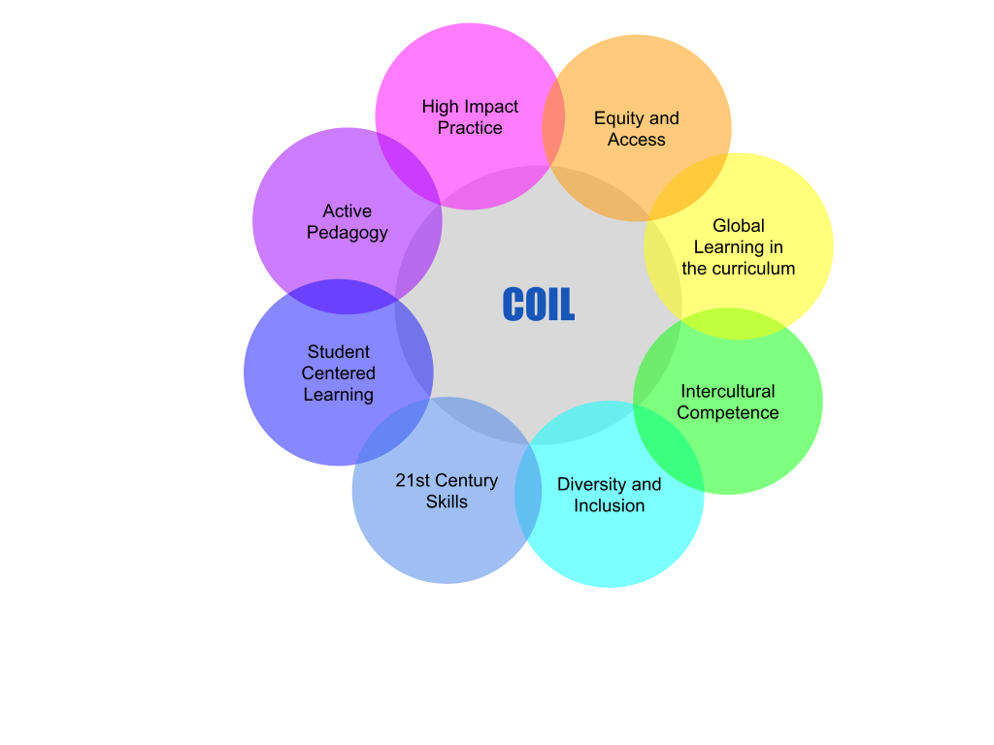
How COIL aligns with Institutional Priorities

Slide 10
Virtual Exchange has been employed in higher ed for 20+ years. COIL began at SUNY in 2004.
Virtual Exchange is a rapidly growing field. SUNY COIL Center is a field leader.
COIL is the gold standard for Virtual Exchange in global higher education.
Since the start of the global pandemic, interest in VE has significantly increased. Emergence of new global consortia in Latin America, Japan, South Africa. International Education organizations fully embracing VE for the first time.
Notes:
Faubai
LatAM
CIGE
South Africa - DUT
FIU
ACE Stevens Initiative
Interest from international ed organizations - AIEA, NAFSA, EAIE, Forum, IDEAs Partners of the Americas - as evidenced by conference focus, support offered to institutions, prizes given
24 SUNY COIL Center presentations in 2020 included US embassy or local government sponsored webinars in the Dominican Republic, Argentina, Colombia, the Philippines, Germany, African Union, regional and national associations, international and national conferences

Slide 11
Examples of COIL Collaborations
COIL supports and benefits from student engagement and faculty creativity

Slide 12
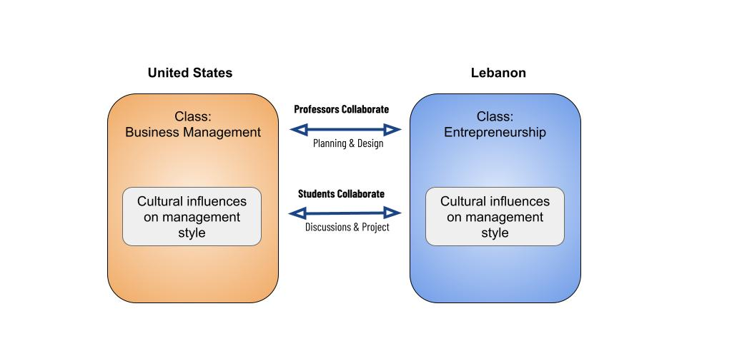

Slide 13
Notes:
Street art, popular music, poetry

Slide 14
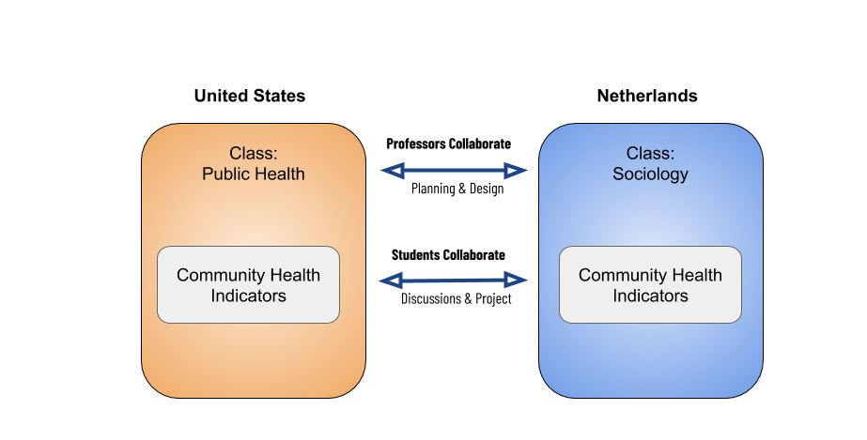

Slide 15
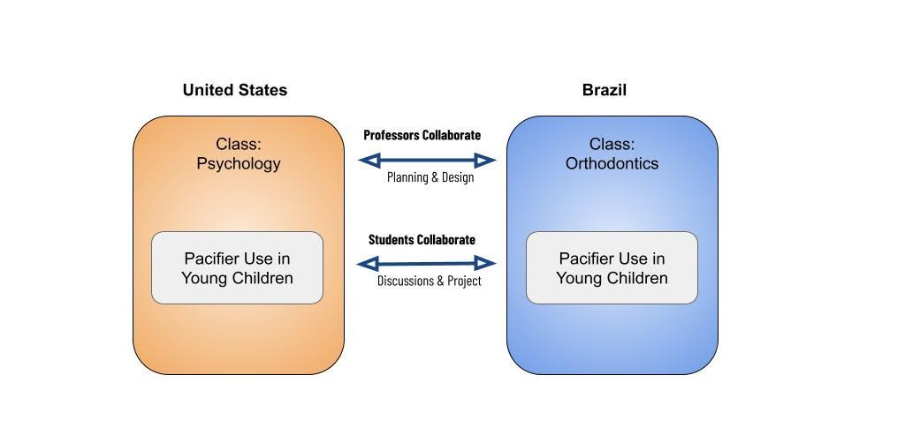

Slide 19
SUNY COIL Center Activities
Training
Worksheets
Exemplars
Workshops
Strategic planning
Global network of practitioners
Monthly meetings
Webinars
Task & working groups
Conferences
Simplifying the process
Professional community of Practice
Making meaningful connections
Resource Development
Partnering fairs
Listserv
Faculty recognition
Regional meet ups
Faculty guide
Institutional asset mapping
Tips and tricks
Evaluation and assessment

Slide 20
2017: SUNY COIL as the center of activities
European Hub - Netherlands
Asia Hub - Japan
Emerging Middle East & North Africa Hub
SUNY COIL Center
SUNY COIL Network
Other Global Partner Network Institutions
Latin America Hub - Mexico
Notes:
Too centralized, too much time spent as the center of communications, did not allow for innovation and growth

Slide 21
2021: Collaborative partner for strategy, training, innovation and leadership
SUNY COIL Global Network
European Hub - Netherlands
Virtual exchange organizations
Other Global institutions
Other US institutions
Middle East & North Africa Hub
Asia Hub - Japan
Latin America Hub - Mexico
Other Global Partner Network Institutions
SUNY COIL Center

Slide 22
AY 2017-18:
2 different PD workshops offered
6 total sessions per year
+/- 250 workshop seats
1 consultancy
AY 2020-21:
6 different PD workshops offered
38 3-week workshop sessions
800+ workshop seats (professors and administrators trained)
12 consultancies
Professional Development

Slide 23
AY 2017-18:
Monthly COIL Coordinator meeting attendance: average 8
COIL Webinars = 0
COIL information sessions = 0
No online community platform
COIL partnering activities = 0 (professors finding teaching partners)
Special interest groups = 0
AY 2020-21:
Monthly COIL Coordinator meeting attendance: average 58
Monthly COIL Webinar attendance: average 55
Monthly COIL information sessions began Dec 2020
Online community platform launched Dec 2020: 300+ professors signed on
Six online partnering fairs + bulletins, average # professors included: 82
5 special interest groups: Culture and Language, Pedagogy, Communications, Assessment, Technology
Community of Practice

Slide 24
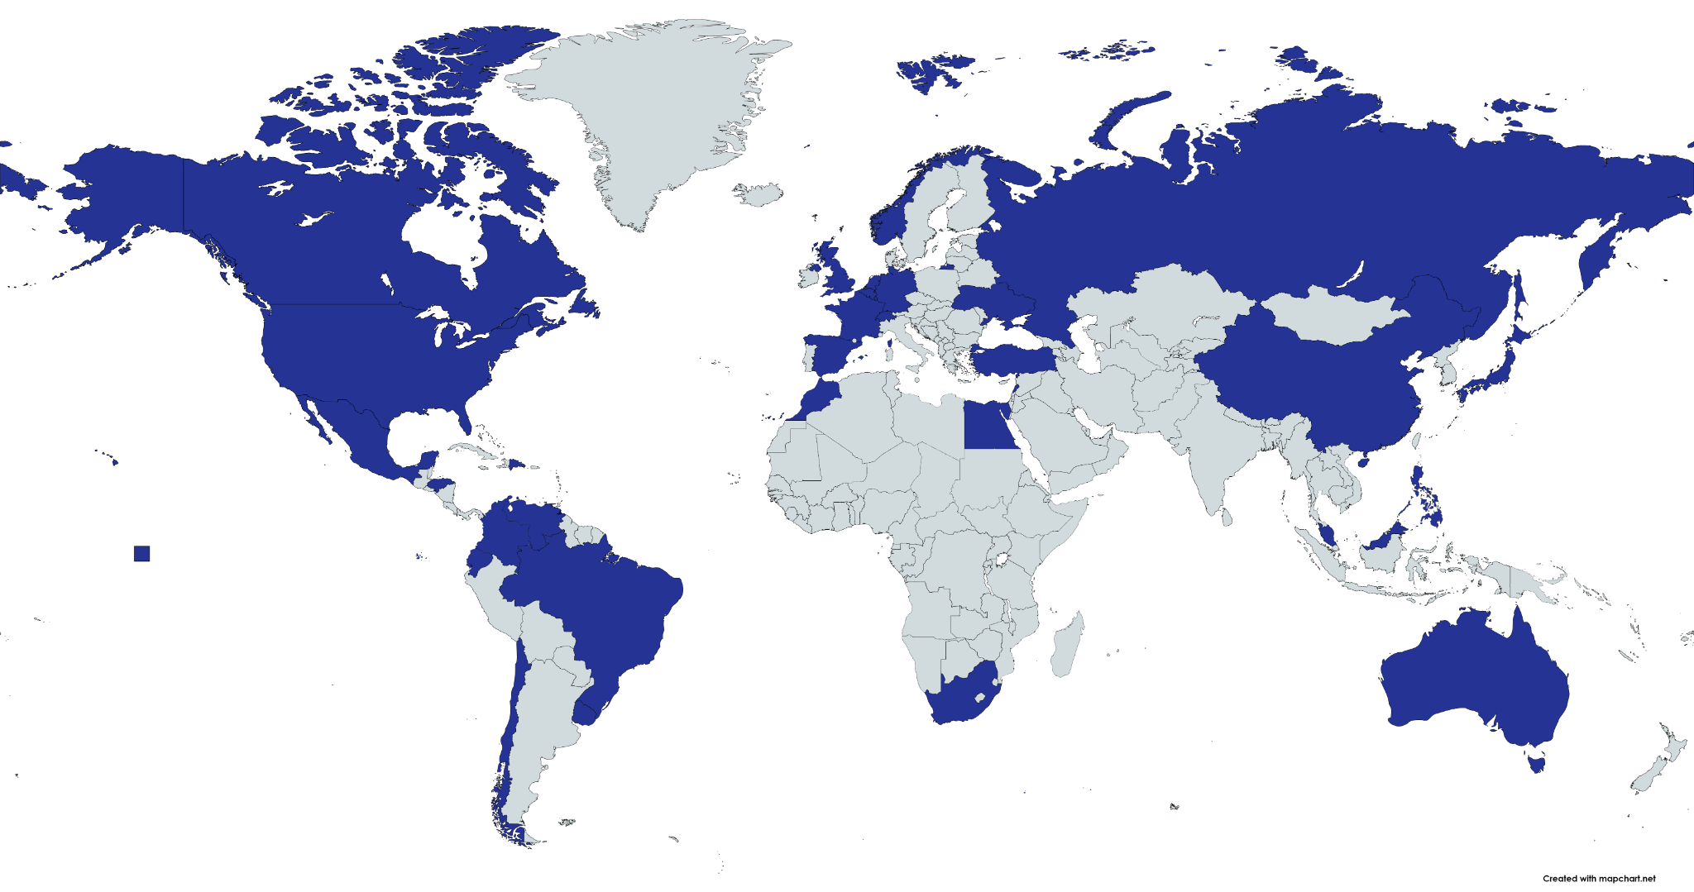
SUNY COIL
Global Network
30 Countries
106 Institutions
[29 SUNY]

Slide 25
SUNY COIL Global Commons 2020 & 21 https://system.suny.edu/global/coil-global-commons/
EOP - COIL pilot for pre-Freshman summer programs
Co-hosting International Virtual Exchange Conference https://iveconference.org
New website & outreach activities https://coil.suny.edu
Additional COIL Initiatives AY 2020-21

