Slide 1
What Difference does Difference Make? facilitated by James B. Childs
WELCOME

Slide 2
Observation
The data we take in utilizing our five senses
(i.e. what we see, touch, taste, hear, smell).
Notes:
Notes to the Facilitator:
Bias, Diversity, and Inclusion (Slides 9-16): 25 minutes
Timing: 15 minutes for the Power of Observation activity (slides 9-12)
This slide includes a build.
Before showing the video on the next slide, direct participants to the image in their Participant Guide of the five people they will meet.
Tell them to not over-think this and to take note of their first 2-3 observations.
-------------------------------------------------
Suggested comments to the class:
ASK: What is an observation? Get a few responses from the class. Quickly correct or confirm.
[CLICK] to reveal and read the definition.
Give activity instructions:
In your Participant Guide, you’ll see a picture with five people. In a moment, you’re going to meet each of these people as they introduce themselves on video. As you meet them, write down 2-3 OBSERVATIONS of each person.

Slide 3
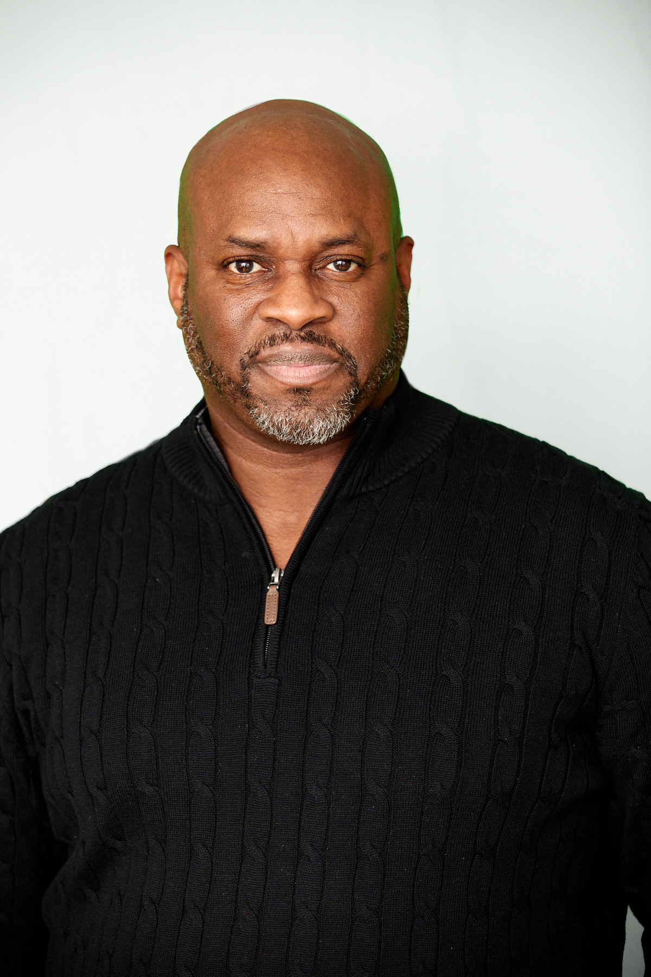
James B. Childs
(ON THE SCRAP PAPER)
List the things you first
noticed/observed about
James Childs upon first
encountering him today.
Be specific. Please focus more on him than what he may have been doing.

Slide 4
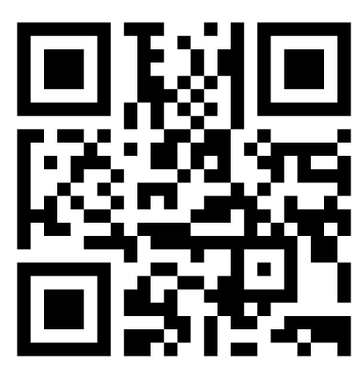
DIVERSITY
Why talk about it?
Scan the QR code
→
OR… go to www.menti.com and use the code 9736 5866

Slide 5
Session OBJECTIVES
De-couple, expand, and explore the definitions of “diversity” and “inclusion”
Increase our general awareness across multiple dimensions of diversity
Begin to clarify and action the impact of diversity & inclusion

Slide 6
Session GUIDELINES
Participate fully
Be an attentive and active listener
First seek to understand, then be understood
Use humor appropriately
Respect confidentiality
Be mindful of time
… any others you would like to add??

Slide 7
Inclusion is achieved when:
Each person’s resources are recognized and routinely utilized in achieving the organization’s goals.
People feel valued, respected, included and encouraged.
People are included as part of the team because their differences in outlook, perspective and background are seen as adding value.
Everyone is fully able to contribute.

Slide 8
How would you feel if this description of INCLUSION described where you spend the most time everyday?
Scan the QR code
→
OR… go to www.menti.com and use the code 9736 5866

Slide 9
JaRa
Consulting
Seeking, Having, Leveraging DIVERSITY

Slide 10
Broadening our Understanding…
From the lists in your participant materials select:
one (1) item from LIST A AND
one (1) item from LIST B
…as factors that have had a major impact on shaping who you are today. (2 minutes)

Slide 11
Broadening our Understanding…
LIST A
LIST B
Age
Disability
Gender
Race/Ethnicity
Sexual Orientation
Communication Styles
Country of Birth
Education
Family Status
Heritage
Languages Spoken
Learning Style
Work Style
Religion
Lifestyle
Work-Family
Relationship Status
Nationality
Political Affiliation
Talents
Values/Beliefs
Work Style
OTHERS

Slide 12
Broadening our Understanding…
From these lists select:
one (1) item from LIST A and
one (1) item from LIST B
…as factors that have had a major impact on shaping who you are today.
In your breakout groups, each of you will have about 2 minutes (uninterrupted) to explain why you selected those items.
Share only what you feel comfortable sharing.

Slide 13
JaRa
Consulting
Debrief

Slide 14
James B. Childs
(ON THE SCRAP PAPER)
List the things you first noticed or observed about James Childs upon first encountering him today.
Be specific. Please focus more on him than what he may have been doing.
Scan the QR code
→
OR… go to www.menti.com and use the code 9736 5866

Slide 15
Write whatever message you
think is contained above .

Slide 16
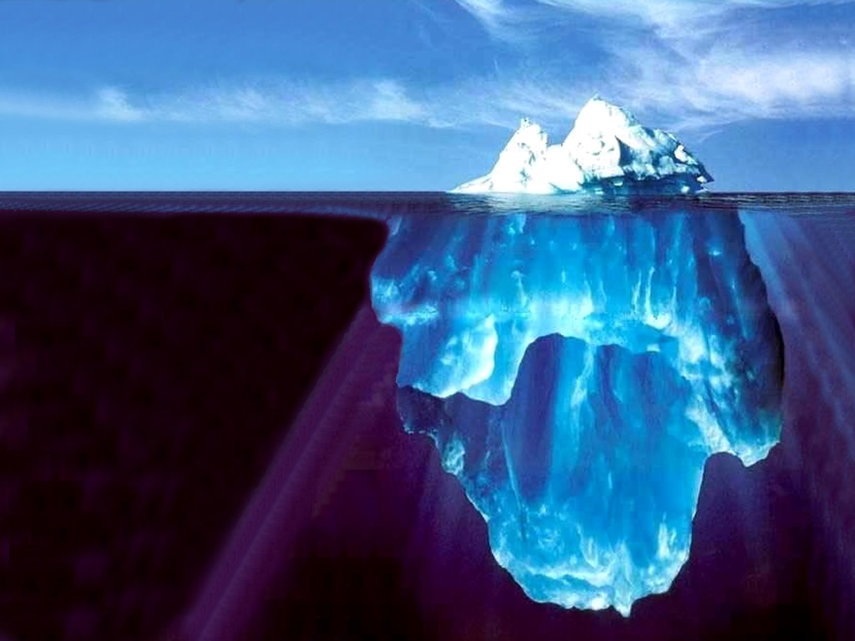
The Dimensions Iceberg
Physical Traits & Characteristics
Voice/Tone
Behaviors
Appearance
ABOVE
Words
BENEATH
Race/Ethnicity
Gender
Values / Beliefs
Abilities
How are people like icebergs?
What do we know about icebergs?
Country of Birth
Education
Experiences
Age
Nationality
Communication Style
Work Tempo
Thinking Styles
Sexual Orientation
Talents
Work Ethic
Family Status
Religion / Spirituality
And so much more….

Slide 17
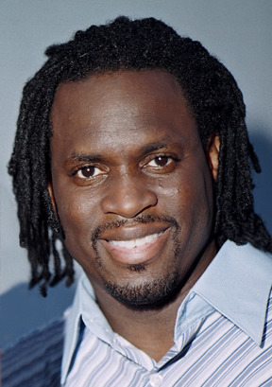
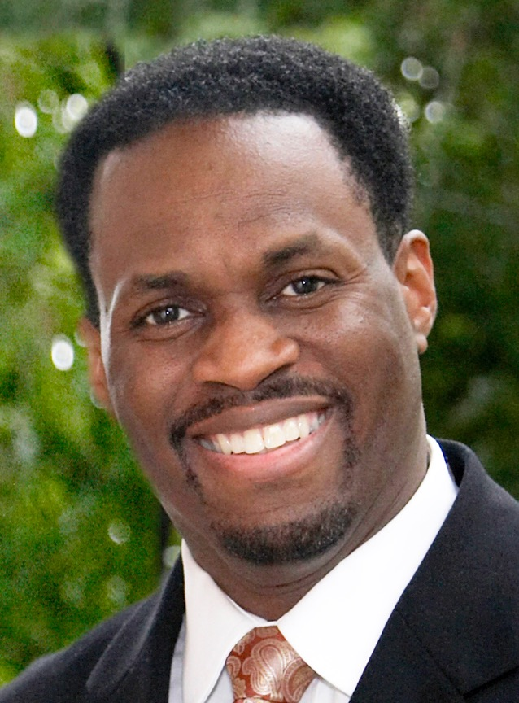
James B. Childs

Slide 18
Definition of Diversity
Diversity is the collection of similarities and differences that we each carry with us at all times, based upon:
Characteristics we were born with,
Experiences we have had, and
Choices we have made.

