Slide 1
Regular and Substantive Interaction
Meeting Student Needs for Engagement

Slide 2
Course Requirements for Spring 2021
Regular Interaction
Substantive Interaction
Assessment/feedback on student coursework
Provision of information or responding to questions about course work
An opportunity for live office hours via phone or web-conferencing (connection beyond email exchange)
Direct instruction
Facilitation of group discussion of coursework or study groups
Facilitation of team projects or student presentations
Opportunities for feedback from students via surveys, discussion boards, or web-conferencing
Other means of ensuring substantive interaction not named above

Slide 3
Regular Interaction
Planning to Engage

Slide 4
What is Regular?
Planned
Predictable
Perpetual
Punctual

Slide 5
Knowledge | Upon completion of the course, students will:
Learning Outcome | Instructional Activities | Assignments
Describe the scope of political science within the 5 sub-fields US government and electoral systems International relations Public policy Political theory/philosophy Empirical/descriptive theories of political science | Read textbook Class lectures Class discussion In class team research design plan (think/pair/share) | Departmental pre-test Open book quizzes Close book, comprehensive Final Exam Low stakes writing assignment Which sorts of questions/methods/approaches are of most interest to you?
Skills | Upon completion of the course, students will:
Learning Outcome | Instructional Activities | Assignments
1. Identify reliable resources that provide accurate information about political science (information literacy) | Bouncing balls and apes It’s not DEMOCRACY/Old or young lady Library tour Acadia tutorial Create a hoax Political lens (and how it blinds us) | Ideology quizzes on line “Googling before Class” (google pro/con gun control re: 2nd amendment, then read 2nd amendment, then chart, compare, evaluate and critique) Analyze an opinion piece Annotated bib
2. Write clearly about politics, policy and/or law | Lecture Class discussion Dept Rubric Reading materials (How to Write Good)… How to write a thesis | Departmental performance task assessment Low stakes writing assignment(s) Critique an essay using the dept rubric Write a persuasive essay articulating your political values in a manner that is well-organized, free of mechanical errors and cites appropriate authorities
3. Exhibit leadership skills | Lecture Discussion Bring in upper classmen as role models Bring in student clubs/organizations | Design and implement a program of study based on the requirements of the major As part of student portfolio extra and co-curricular activities Peer review assignment
Attitudes | Upon completion of the course, students will:
Learning Outcome | Instructional Activities | Assignments
1. Develop an interest to take action or be engaged | Lecture Discussion Bring in upper classmen as role models Bring in student clubs/organizations | Activity passport Engage in curricular and co-curricular opportunities identified in Skills #4
2. Value holistic reflection about one’s learning | Lecture Discussion | Design and implement a student portfolio
Course Mapping Sample

Slide 6
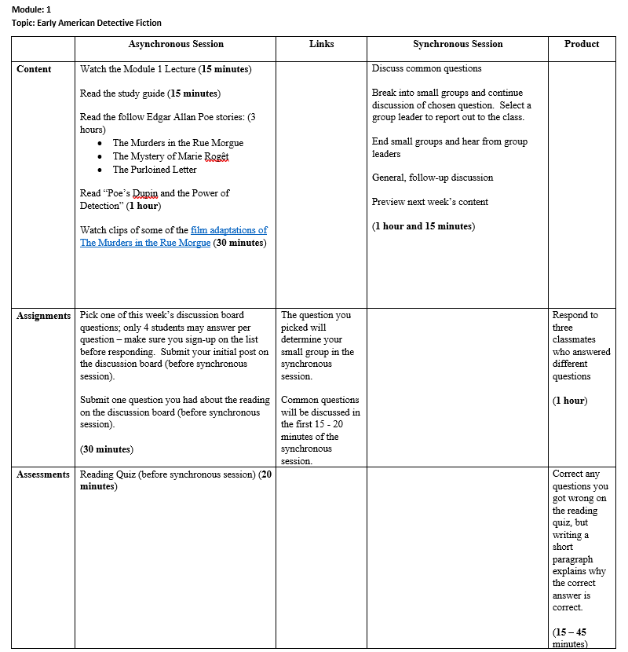
Module Mapping Template

Slide 7
Assessment/feedback on student coursework
Setup grade-center from the start
Return grades in a “reasonable” amount of time
Utilize commenting features when grading assignments
Using Knowmia to record narrated feedback on assignments
Schedule group feedback sessions
Create milestone assignments (either instructor or peer reviewed)
Notes:
What does reasonable mean? Before next step in a project, before next test, before transition to next unit

Slide 8
Provision of information or responding to questions about course work
Have an accessible syllabus
01
Post course announcements at least weekly (use email option)
02
Be sure your course includes the following:
03
Course Orientation
Module 0
Create a general Q&A Forum
04

Slide 9
An opportunity for live office hours via phone or web-conferencing (connection beyond email exchange)
Scheduled day(s) and time(s)
BUT flexibility for appointments (if possible)
Private vs. group office hours
Group feedback sessions (built into course time or optional and recorded alternate time)

Slide 10
Substantive Interaction
Engaging Fully

Slide 11
Direct Instruction
Instructor Presence in ALL Modules
Introduction
Context and Explanation
Summary, Questions, and Next Steps
Consistent Labeling
Accessible Content
Don’t leave yourself out of your online course!!

Slide 12
Synchronous Direct Instruction
Less emphasis on lectures, more interpersonal interaction
Plan for meaningful interactions
Faculty to student
Student to student
Suggestions for meaningful interactions:
Use polls to engage students, check understanding
Bring in outside web or cloud resources
Have students respond on shared documents
Encourage students to share resources with the class/group

Slide 13
Asynchronous Direct Instruction
Recorded lectures with interactive elements
Knowmia (quizzes and conversations)
Combine video with quiz or activity in LMS
Commenting on asynchronous discussions
Comments on ongoing cumulative assignments (ex. Journals)
Open or close a module with a “dialogue”
Adding timely materials and comments to the course
Recent articles, publications, multimedia
Commentary or discussion of current events

Slide 14
Facilitation of group discussion of coursework or study groups
Demo
Guide
Mediate
Be Present
Reconnect
Ensure students know about and can use available tools
What is expected in small group sessions?
Expect to assist in managing conflicts
Observe and respond throughout breakouts
Have small groups report out to the class

Slide 15
Facilitation of team projects or student presentations
Meet Individually with Small Groups
Have regular, quick check-ins on project development (can be peer review)
Hold milestone meetings before project due dates
Group Presentations (Live)
Have students present projects live through web-conferencing
Scaffold this type of assignment by having students use share tools ahead of time
Group Presentations (Pre-recorded)
Ex. Have students in a business class pitch a product or service
Ex. Hold conversation sessions for language classes
Group presentations (where appropriate) take less time and allow for more substantive feedback
Groups produce and post a presentation
Other students watch/read presentation and leave constructive comments
Instructors provide summative assessment and feedback

Slide 16
Opportunities for feedback from students via surveys, discussion boards, or web-conferencing
Remote learning survey (built into default shell)
General class discussion board for questions
“Watercooler” message board for social interactions
Listening sessions for feedback and suggestions
Student access to web-conferencing for virtual meetings
Log in 5 – 10 minutes before a session

Slide 17
Questions and Feedback
What questions can we answer? What feedback can you share?
Reach out to us:
Office of Instructional Technology | Faculty Development Center | Graduate and Extended Learning
Kate Bohan | bohank@newpaltz.edu Rich McElrath | mcelratr@newpaltz.edu General Support | support.newpaltz.edu | Sarah Wyman | wymans@newpaltz.edu | Shala Mills | mills@newpaltz.edu

