Slide 1
Welcome to Digital Media & Journalism Group Advising
We’ll cover what Production, Management and Journalism majors need to know and do to plan your Fall ’23 schedules

Slide 2
Welcome to Group Advising! Here’s how it will work
Major overviews: Production, Management, Journalism
Internship eligibility
How to read the Progress Report
Important dates
My Schedule Planner quick tips
Check for holds & confirm your time assignment

Slide 3
DMJ: Three majors, one department
Digital Media Production
Digital Media Management
Journalism

Slide 4
Digital Media Production focuses on content creation: video, audio, television, film, multimedia/multiplatform
Fundamentals:
Digital Storytelling
Writing for Digital Media
Audio Production
TV Studio Production
Advanced classes:
Field Production
Seminar in Digital Filmmaking
Electives include Podcasting, Animation, Mass Media Law, Photojournalism, Media Ethics, film courses, and much more.

Slide 5
Digital Media Management focuses on content management and programming.
Pitching, Coordinating
Programming, Strategy
Sales, Marketing, Advertising
for television networks, film festivals, streaming services, and other platforms.
Fundamentals:
DMJ224 Media Industries
DMJ323 Digital Media Content & Tech (**Being replaced by DMJ310 Diversity & Media)
Advanced classes focus on research projects/papers:
DMJ434 Global Media (**fall only)
DMJ350 Media Research Methods (**fall only)
DMJ444 Seminar in Media Studies (capstone/**spring only)

Slide 6
The media management major has a few courses outside our department
BUS325 Marketing requires permission (BUS School sets protocol) and MPL 4 (If lower, take BUS325 at a community college or find a substitution like CMM353 Persuasion & Social Influence or CMM315 Intro to Strategic Comm)
CMM104 Public Speaking
BUS electives don’t have pre-reqs (Principles of Mgt, Legal Environment of Bus, Financial Accounting)

Slide 7
Management majors have options for the media production requirement
DMJ300 PhotoJ has no pre-reqs
DMJ340 TV Studio requires DMJ319, 215 & Permission of Instructor
Substitutions can be made if you have other production interests (Podcasting, Audio Production, etc.)

Slide 8
Journalism majors focus on writing, editing, producing multimedia for the web
https://www.newpaltz.edu/ugc/las/digitalmedia_journ/
Foundation courses:
DMJ210 Investigating the News
DMJ230 Journalism I
DMJ215 Digital Storytelling
Advanced courses:
DMJ332 Journalism II (**spring only)
DMJ347 Media Ethics
DMJ453 MM Editing/Publishing: The Little Rebellion (**fall only)
DMJ458 Capstone Seminar in MM Reporting (**spring only)

Slide 9
Along the way, Journalism majors take "Contexts" and "Genre" electives
Contexts: Mass Media Law, Media Theory, Picture Culture, Media & Diversity, etc.
Genres (types of reporting): Feature Writing, Podcasting, Arts Writing, Photojournalism, etc.)
Ottaway Seminar course can fulfill either a Context OR a Genre

Slide 10
Beyond the required courses, you choose Electives
We encourage you to choose DMJ electives
DMJ 100:499 means ANY DMJ course from 100-level through 499. DMJ 300:499 means UPPER-Division DMJ courses
Consult the Schedule of Classes to see all our offerings – and check any restrictions or pre-requisites

Slide 11
Electives for Fall (prerequisites are in parentheses)
DMJ300 Photojournalism
DMJ310 Media & Diversity (DMJ101)
DMJ314 Feature Writing (WI; open to all majors)
DMJ333 Podcasting (DMP & JRN majors)
DMJ343 Media Criticism & Aesthetics (WI)
DMJ347 Media Ethics
DMJ388 Digital Animation & Visual Effects (DMJ340)
DMJ390 90 Minutes to Die: Film Noir
DMJ399 Art of the Pitch (1 credit; Juniors/Seniors)
DMJ432 Media & Popular Culture (WI, DMJ101)
DMJ434 Global Media (DMJ101)
DMJ452 Mass Media Law
DMJ470 Ottaway Seminar (JRN, Juniors/Seniors)
DMJ475 Picture Culture (WI)
DMJ499 Woodstock Film Festival (1 credit; must have transportation to festival)

Slide 12
New for Fall 2023
3-credit Media & Diversity
It will be offered every semester and is a great UD elective for all majors (Prereq: DMJ101)

Slide 13
Amazing Extracurriculars/Open to All
An opportunity to practice what you're learning or try something new.
New Paltz Oracle
The Teller magazine
WFNP Radio
Hawk Studios TV station
Blogs, zines, etc.
Media Society (hosts Media Day each spring)

Slide 14
Internships are Mandatory for DMJ Majors
Once you have:
60 total credits (junior or senior)
30 credits at SUNY New Paltz
18 credits in the major (in progress or completed)
2.5+ GPA
Then, APPLY FOR CERTIFICATION to look for an internship
tinyurl.com/npinternpacket
Do this as soon as you meet the criteria, but before the
2nd Friday in November for Spring;
2nd Friday in April for Summer or Fall
Once you are ELIGIBLE to seek an internship, begin your search:
Instagram @npcommedia, Handshake, the BIG List:
tinyurl.com/npbiglist
Get placement approved by Internship Coordinator Nancy Heiz

Slide 15
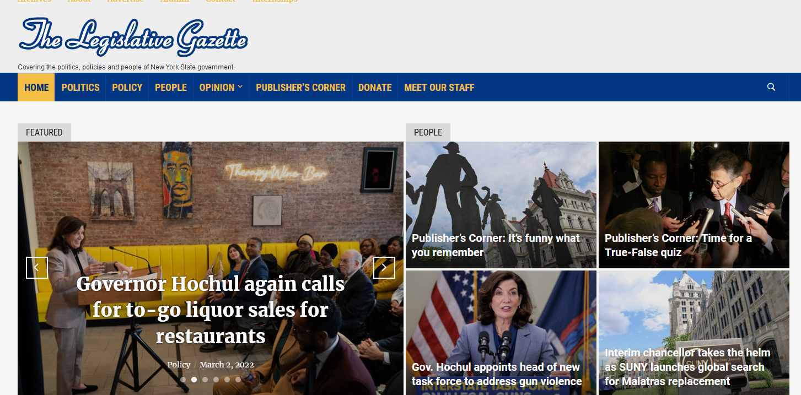
The Legislative Gazette in Albany is the premier DMJ internship (and scholarships are available) open to all majors

Slide 16
For the required internship, there are lots of opportunities for DMJ majors:
Television: ABC, NBC, CBS, MTV, Viacom, Comedy Central (The Daily Show, The Colbert Report), Adult Swim, Time Warner Cable, AMCtv, IFCtv, Discovery Channel, and many others
Radio: NYC Radio Market, Hudson Valley Radio Market (Townsquare Media, iHeart Radio, Radio Woodstock, Radio Kingston), various genres and responsibilities
Film: 40 Acres and a Mule (Spike Lee), BCDF Productions (films such as ‘Peace Love and Misunderstanding’ and ‘Higher Ground’), Mandalay Film, numerous independent films and production companies
Digital Media: Hearst Digital (Esquire, Cosmo, etc.), NBC iLearn, Refinery29, Vox, Mashable and other web video companies/branches
Publications: The Legislative Gazette, Hudson Valley Magazine, Chronogram, Journal News, LI Herald, etc.

Slide 17
You’ll find many answers on our DMJ News Hawksite
DMJ News site – You’ll find answers to common questions like how to declare a minor, how to do an internship, etc.
Subscribe to updates and weekly newsletters:
https://hawksites.newpaltz.edu/dmjnews

Slide 18
Highlights for Fall ’23
Media & Diversity
Reminder…
Media Management senior seminar ONLY in Spring:
DMJ444 Seminar in Media Studies
Media Management core courses ONLY in Fall:
DMJ350 Media Research Methods
DMJ434 Global Media
Journalism core courses ONLY in Spring:
DMJ332 Journalism 2
DMJ458 Capstone Seminar in MM Reporting

Slide 19
Questions?

Slide 20
Fall ’23 Advising & Scheduling
We’ll work with you individually. Please help fellow students if you’ve completed your draft schedule.

Slide 21
Follow these best practices for advising
Get to know your major advisor. Beyond scheduling and policies, they can advise you on courses, grad school, internships, careers, etc.
Become familiar w/Academic Calendar (ex: S/U deadlines; can’t add courses after first week; all policies and forms are linked)
https://www3.newpaltz.edu/calendars/
Use only New Paltz email account for any school matters
Include your Banner (N) number on ALL emails about advising, schedules, registration, etc.

Slide 22
Have you submitted your most recent Official Transcript, that shows final grades from this semester? And shows you earned an Associate’s degree (if applicable)?
If not, please submit that BEFORE CLASSES BEGIN

Slide 23
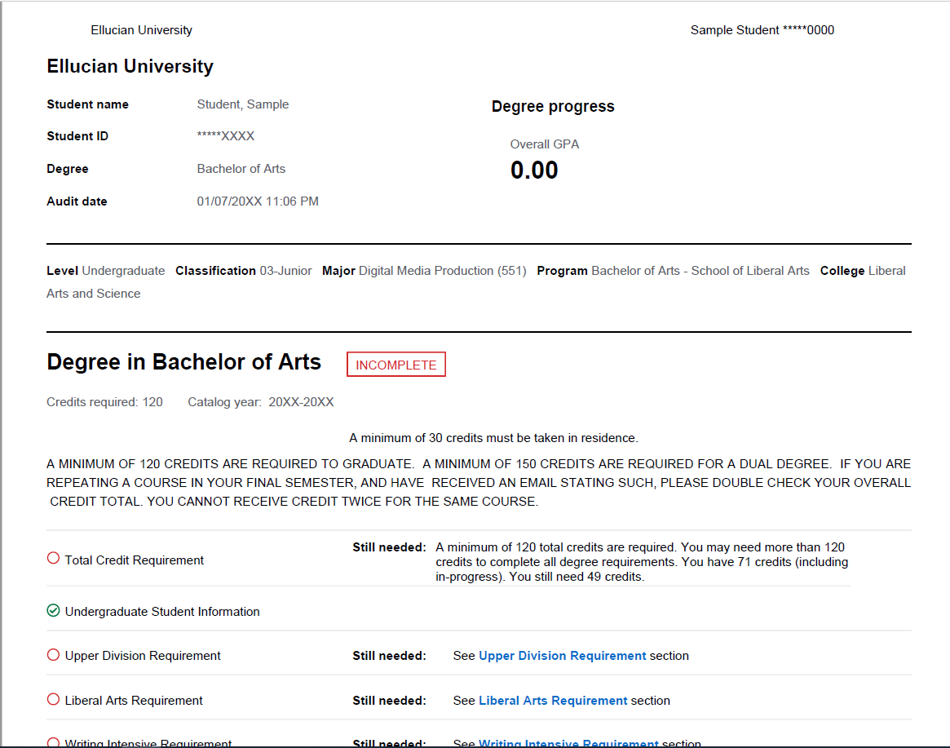
Understand how to read your Progress Report
Notes:
https://hawksites.newpaltz.edu/dmjnews/production-major-progress-report/
The file is also on our shared Teams folder: https://sunynp.sharepoint.com/:b:/r/sites/dmjteam/Shared%20Documents/General/Advising%20Resources%20to%20Share%20with%20Students/SAMPLE%20DMP%20STUDENT%20PROGRESS%20REPORT.pdf?csf=1&web=1&e=iKoIaC
Point out:
Grad requirements: 120 total credits, GE, WI, DIVR, LA and Major
--DMJ offers a few WI options, plus a GE HUMANITIES WI option that fulfulls UD LA and Electives for Prodn and Mgt majors
--Transfers be aware of UD totals
--BA vs BS – it’s a quick change we can make in senior year if you don’t have enough to meet the 90 LA before graduation
(More info here:
https://hawksites.newpaltz.edu/dmjnews/?s=liberal+arts

Slide 24
Check for HOLDS and clear them before you register
In my.newpaltz.edu under General > Holds – If you have an ACTIVE (red) HOLD that says it “affects registration” you MUST ADDRESS THAT in order to be permitted to register on your Time Assignment
Notes:
https://hawksites.newpaltz.edu/dmjnews/2022/02/14/clear-all-holds/

Slide 25
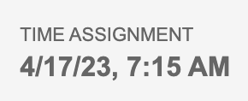
Verify your Registration Time Assignment and mark it on your calendar
Your Time Assignment is the actual day/time appointment you register yourself for fall. What we’re doing here is preparing you for that.
In my.newpaltz.edu under Registration > Time Assignment, there’s a day and time – That’s the earliest you can register, but you should not wait any longer than that.
Example:

Slide 26
We use My Schedule Planner to draft schedules
Brief overview
Always have back-up plans (several “Favorites” saved)

Slide 27
Time to review your schedule
My Schedule Planner
Speak up if there’s something you aren’t sure about
This is a group advising session. We appreciate your patience!

Slide 28
When your schedule is drafted and you're waiting for your advisor to review it, discuss your plans with your fellow students.
Tips and tricks to share?
Need help getting started?
Your advisor will review your draft and release you to register

Slide 29
Questions?

