Slide 1
Welcome to Comm Studies Group Advising
We’ll cover what Communication majors need to know and do to plan your Fall ’23 schedules

Slide 2
Welcome to Group Advising! Here’s how it will work
Major overview; Concentrations
Internship eligibility
How to read the Progress Report
Important dates
My Schedule Planner quick tips
Check for holds & confirm your time assignment

Slide 3
Communication Studies: One major with three concentrations
Relational Communication (1:1 and small group)
Organizational Communication (groups, organizations)
Strategic Communication (PR)

Slide 4
Communication Majors (all)
The major in Communication Studies emphasizes an understanding of communication principles and humanistic approaches to communication studies as well as the development of skills in organizational, relational and strategic contexts. The major provides a foundation for graduate work or for a career in any profession that deals with the public, such as politics, law, business, social work, or teaching.
Required core courses (all concentrations).......15 credits CMM104 Public Speaking (3) CMM202 Interpersonal Communication (3) CMM315 Introduction to Strategic Communication (3) CMM353 Persuasion & Social Influence (3) CMM360 Organizational Communication (3)

Slide 5
Relational Communication
Concentration in Relational Communication
Professional communication skills course..........3 credits CMM302 Business & Professional Communication (3)
Required methods course....................................3 credits Select one of the following: CMM352 Qualitative Communication Research Methods (3) CMM354 Quantitative Communication Research Methods (3)
Concentration electives.........................................9 credits Select three of the following: CMM214 Storytelling & Culture (3) CMM325 Computer-Mediated Communication (3) CMM355 Nonverbal Communication (3) CMM359 Communication Among Cultures (3) CMM374 Language & Everyday Conversation (3) CMM379 Communication, Culture & Difference (3) CMM389 Perceptions of Diversity in Communication (3) CMM452 Communication & Gender (3)
Elective courses....................................................6 credits, including at least 3 upper-division credits
Capstone seminar................................................4 credits CMM455 Relational Communication Seminar (4)

Slide 6
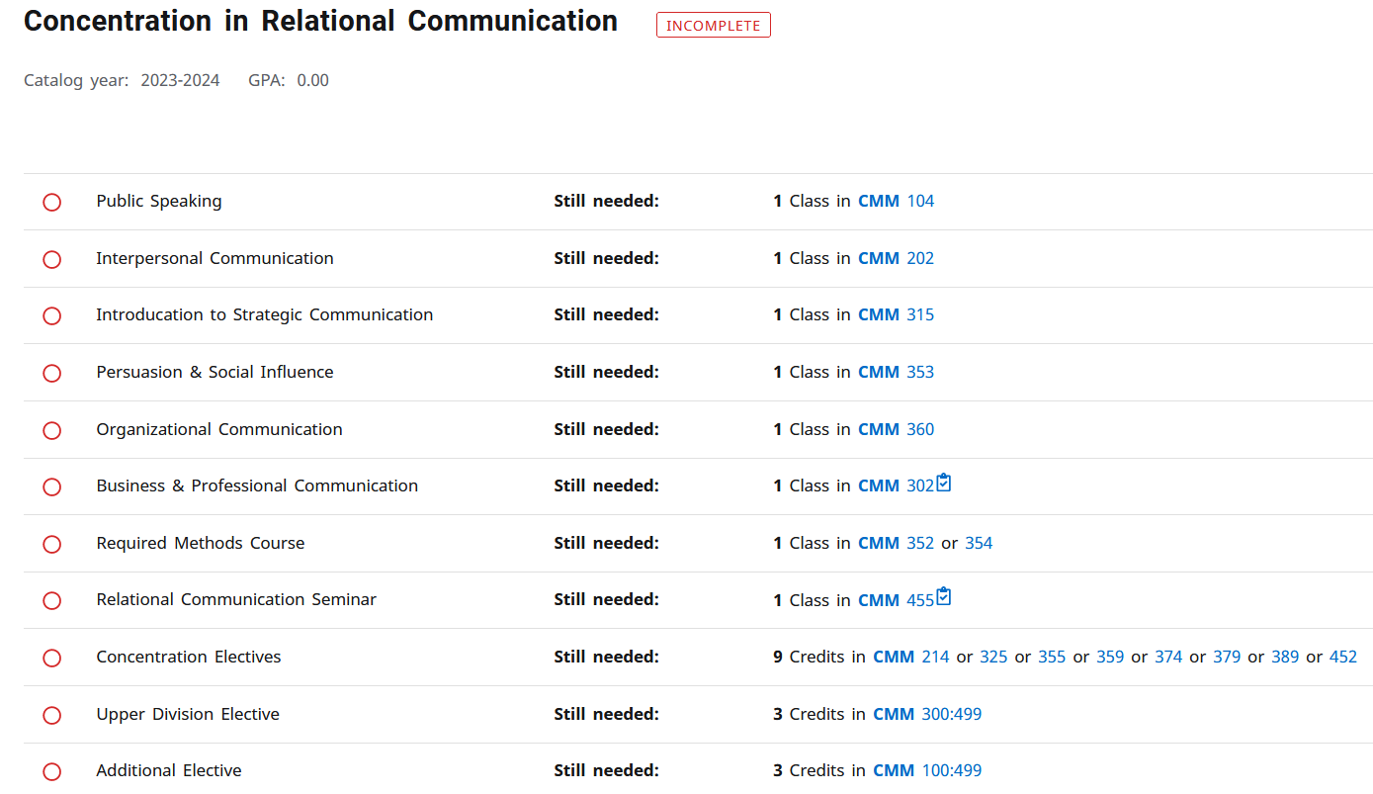

Slide 7
Organizational Communication
Concentration in Organizational Communication
Professional communication skills course..........3 credits CMM302 Business & Professional Communication (3)
Required methods course....................................3 credits Select one of the following: CMM352 Qualitative Communication Research Methods (3) CMM354 Quantitative Communication Research Methods (3)
Concentration electives.........................................9 credits Select three of the following: CMM204 Small Group Communication (3) CMM318 Organizational Reputation & Stakeholder Engagement (3) CMM334 Communicating Corporate Social Responsibility (3) CMM362 Leadership & Communication (3) CMM374 Language & Everyday Conversation (3) CMM430 Training & Development (3) CMM450 Negotiation CMM452 Communication & Gender (3)
Elective courses....................................................6 credits, including at least 3 upper-division credits
Capstone seminar................................................4 credits CMM454 Organizational Communication Seminar (4)

Slide 8
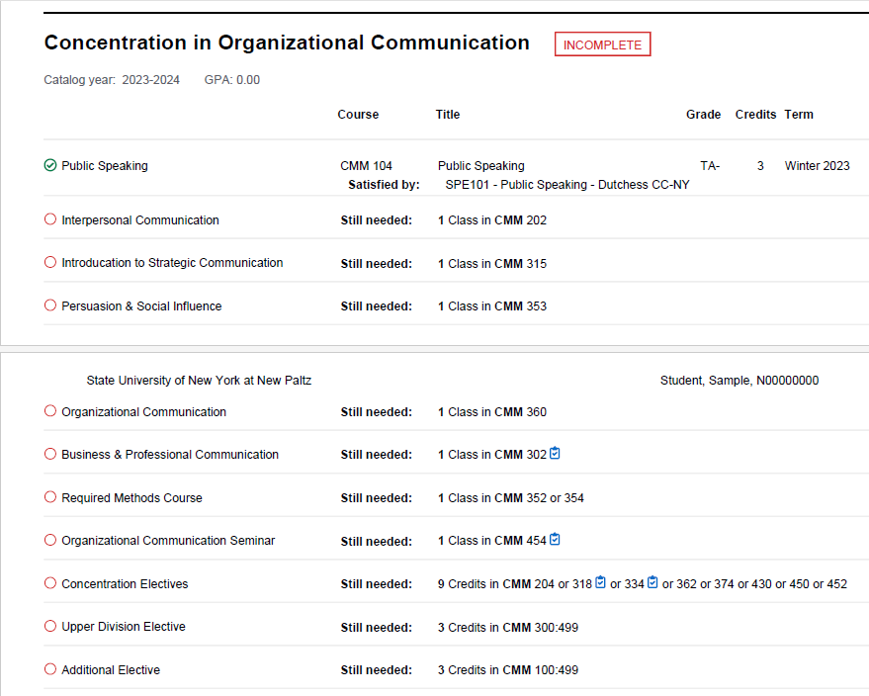

Slide 9
Strategic Communication
Concentration in Strategic Communication
Professional communication skills course..........3 credits CMM231 Writing for Public Relations (3)
Required methods course....................................3 credits Select one of the following: CMM352 Qualitative Communication Research Methods (3) CMM354 Quantitative Communication Research Methods (3)
Intermediate concentration core........................9 credits CMM312 Design & Public Relations (3) CMM316 Strategic Public Relations Campaigns (3) CMM317 Social Media & Public Relations (3)
Concentration electives.......................................6 credits Select two of the following: CMM318 Organizational Reputation & Stakeholder Engagement (3) CMM324 Crisis, Risk & Disaster Communication (3) CMM326 Environmental Communication (3) CMM334 Communicating Corporate Social Responsibility (3) CMM375 Social Change & Advocacy Communication (3) CMM451 Political Communication (3)
Capstone seminar.............................................4 credits CMM456 Seminar in Strategic Communication (4)

Slide 10
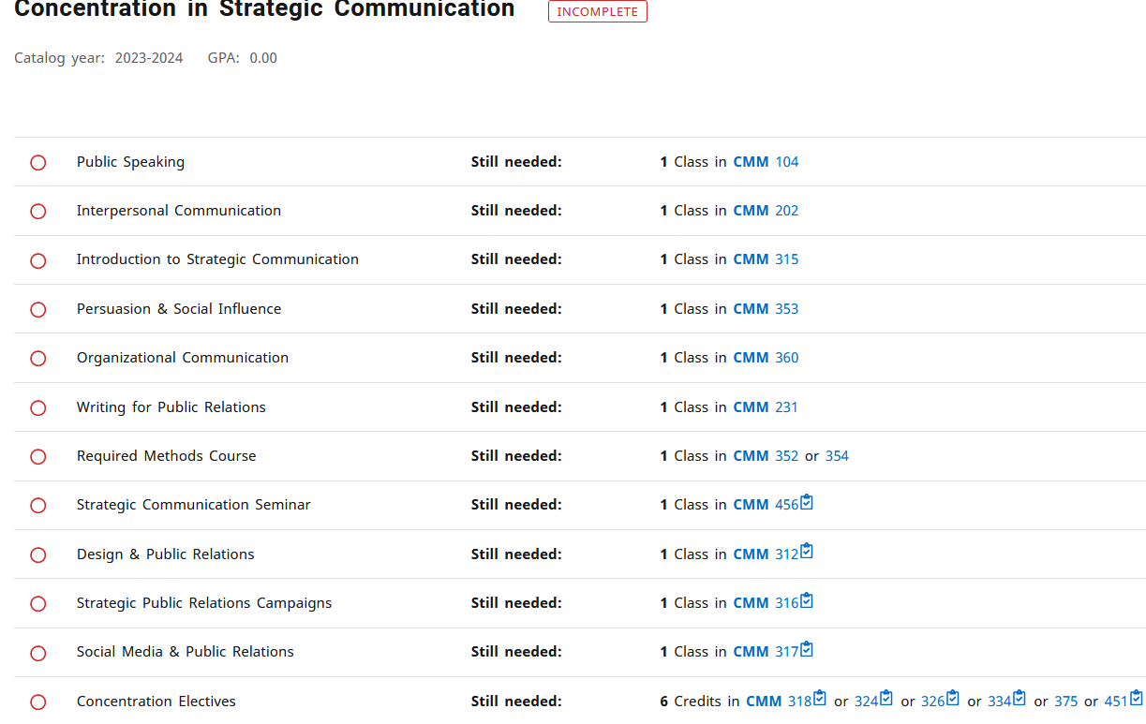

Slide 11
Beyond the required courses, you choose Electives
CMM 100:499 means ANY CMM course from 100-level through 499.
CMM 300:499 means UPPER-Division CMM courses
Consult the Schedule of Classes to see all our offerings – and check any restrictions or pre-requisites

Slide 12
Communication Electives (for Comm students)

Slide 13
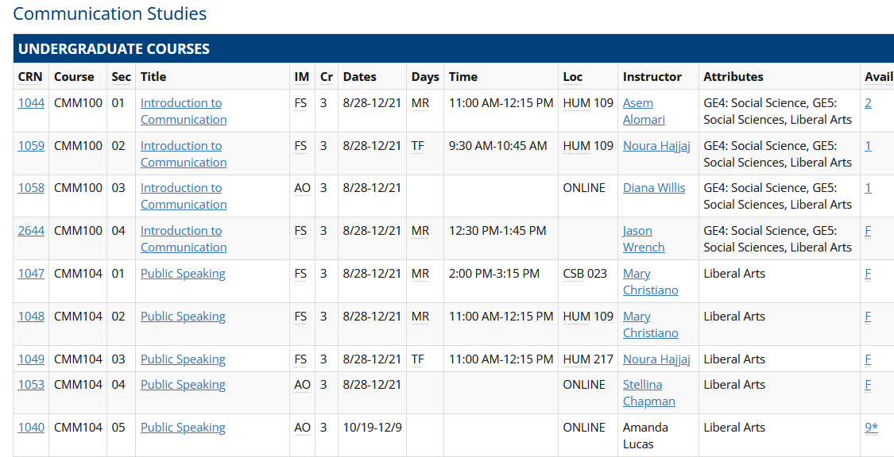
You need to know how to read the Schedule of Classes; it's full of important info!
Main NP website: Newpaltz.edu > Academics > Schedule of Classes

Slide 14
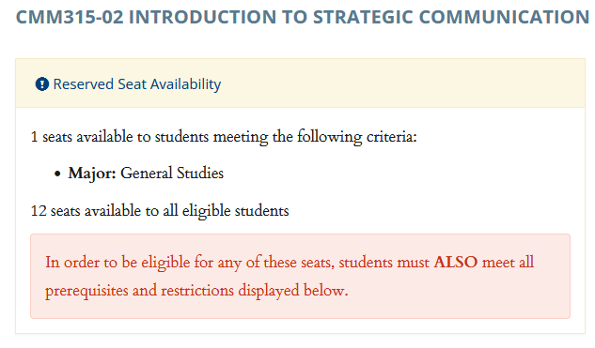
That Asterisk* Means Restricted!

Slide 15
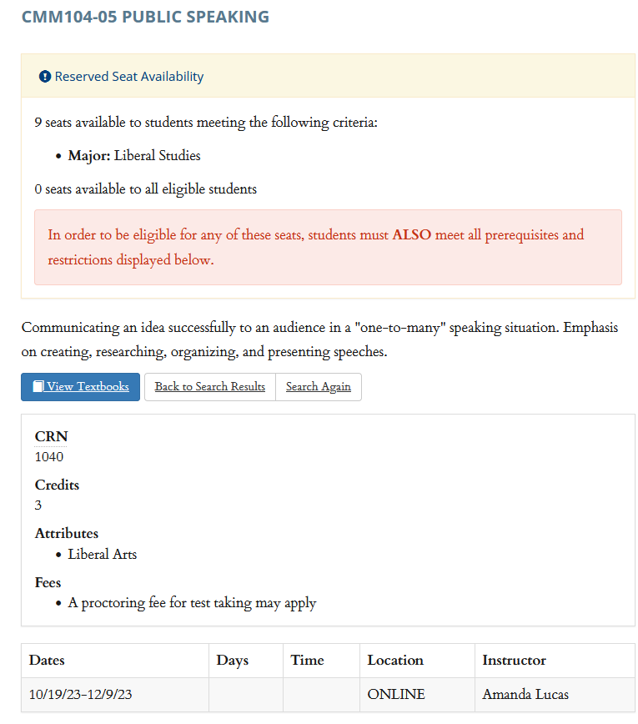
Read the Description, Restrictions, Prerequisites for Each Course You Want

Slide 16
Internships are an Option for CMM Majors
Options for Comm students are vast -- you can work virtually anywhere.
We regularly see Comm students intern:
For Non-profits
In Human Resources departments
As management trainees
In Public Relations posts
At agencies (media agencies, travel agencies, etc.)
At banks, car rental companies, big department store chains, other retailers
For small companies trying to establish themselves in their markets.

Slide 17
Interested? Must get certified eligible ONE SEMESTER before looking for an internship
Once you have:
60 total credits (junior or senior)
30 credits at SUNY New Paltz (in progress or completed)
18 credits in the major (in progress or completed)
2.5+ GPA
Then, APPLY FOR CERTIFICATION to look for an internship
tinyurl.com/npinternpacket
Do this as soon as you meet the criteria
Once you are ELIGIBLE to seek an internship, begin your search:
Instagram @npcommedia, Handshake, the BIG List:
tinyurl.com/npbiglist
Get placement approved by Internship Coordinator Nancy Heiz

Slide 18
Have you submitted the most recent Official Transcript, that shows final grades from this semester? Or shows you earned an Associate’s degree?
If not, please submit that BEFORE CLASSES BEGIN

Slide 19
You’ll find many answers on our Hawksites blog:
You’ll find answers to common questions like how to declare a minor, how to do an internship, etc.
Subscribe to updates and weekly newsletters:
Comm News site -- https://hawksites.newpaltz.edu/comm/

Slide 20
Questions?

Slide 21
Fall ’23 Advising & Scheduling
We’ll work with you individually. Please help fellow students if you’ve completed your draft schedule.

Slide 22
Follow these best practices for advising
Get to know your major advisor. Beyond scheduling and policies, they can advise you on courses, grad school, internships, careers, etc.
Become familiar w/Academic Calendar (ex: S/U deadlines; can’t add courses after first week; all policies and forms are linked)
https://www3.newpaltz.edu/calendars/
Use only New Paltz email account for any school matters
Include your Banner (N) number on ALL emails about advising, schedules, registration, etc.

Slide 23
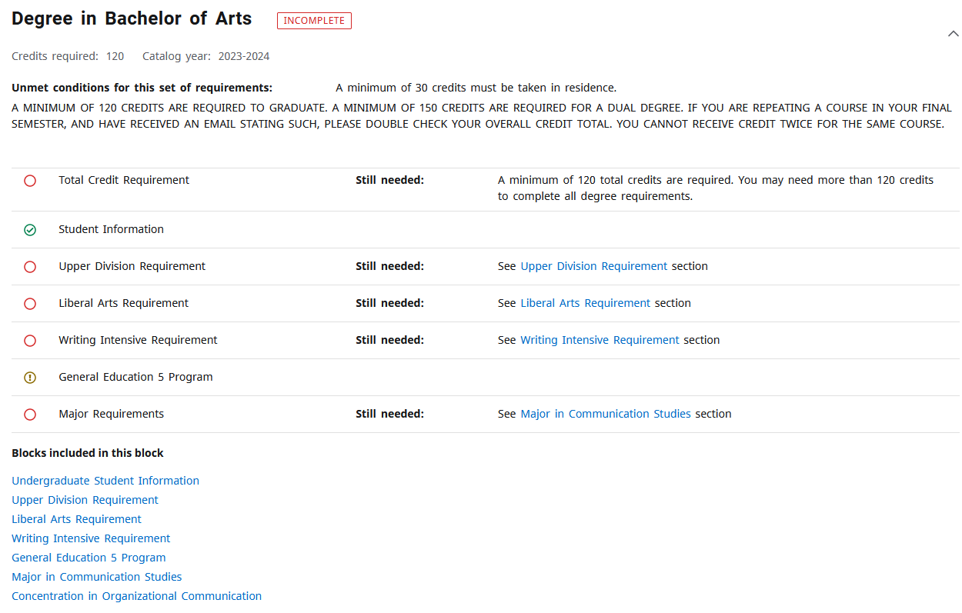
Understand Your Progress Report and the Path to Graduation

Slide 24
Check for HOLDS and clear them before you register
In my.newpaltz.edu under General > Holds – If you have an ACTIVE (red) HOLD that says it “affects registration” you MUST ADDRESS THAT in order to be permitted to register on your Time Assignment
Notes:
https://hawksites.newpaltz.edu/dmjnews/2022/02/14/clear-all-holds/

Slide 25
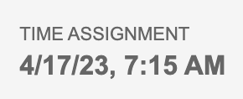
Verify your Registration Time Assignment and mark it on your calendar
Your Time Assignment is the actual day/time appointment you register yourself for classes. What we’re doing here is preparing you for that.
In my.newpaltz.edu under Registration > Time Assignment, there’s a day and time – That’s the earliest you can register, but you should not wait any longer than that.
Example:

Slide 26
We use My Schedule Planner to draft schedules
Brief overview
Always have back-up plans (several “Favorites” saved)

Slide 27
Time to review your schedule
My Schedule Planner
Speak up if there’s something you aren’t sure about
This is a group advising session. We appreciate your patience!

Slide 28
When your schedule is drafted and you're waiting for your advisor to review it, discuss your plans with your fellow students.
Tips and tricks to share?
Need help getting started?
Your advisor will review your draft and release you to register

Slide 29
Questions?

